Slide 1
OpenCL from Experience
Dmitri Nikulin
Freelance software engineer
dnikulin@gmail.com

Slide 2
Scope
OpenCL standards 1.0 and 1.1
Implementations from AMD, NVIDIA, Intel
Integration with C++ projects
Performance on commodity devices
OpenCL vs CUDA
Extra curiosities
Conclusions

Slide 3
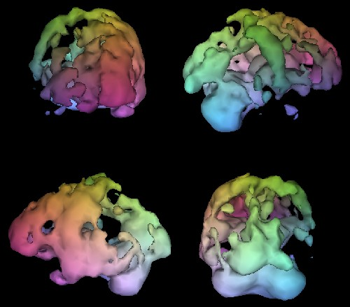
My “Why”: Medical imaging
Brain SPECT showing Alzheimer’s.
2011 © Cedars-Sinai. All Rights Reserved.

Slide 4
OpenCL standards
1.0 (2009)
  Fully supported by AMD, Intel, IBM, NVIDIA
  Comprehensive and has official extensions/options
  Enough to replace almost all CUDA code
1.1 (2010)
  Fully supported by AMD, Intel, IBM
  Certified but not released by NVIDIA
  Fills niche gaps left by 1.0

Slide 5
Commodity device support
 | NVIDIA |  | AMD |  | Intel |  | IBM
 | GPU | CPU¹ | GPU | CPU² | GPU | CPU² | SPU³ | CPU
C/C++ | ✗ | ✓ | ✗ | ✓ | ✗ | ✓ | ✓ | ✓
OpenCL | ✓ | ✗ | ✓ | ✓ | ✗ | ✓ | ✓ | ✓
CUDA | ✓ | ✗ | ✗ | ✗ | ✗ | ✗ | ✗ | ✗
NVIDIA Tegra, not supported by CUDA or any known OpenCL
All x86 and x86-64 CPUs are supported by AMD APP SDK, Intel OpenCL SDK, and Apple Mac OSX’s OpenCL
IBM Cell Broadband Engine

Slide 6
OpenCL implementations (1 of 3)
Outside OSX, AMD APP SDK is the best
  Virtually bug-free
  Supported on Linux and Windows
  Any x86 32-bit or 64-bit CPU
    Generates SIMD instructions
    Supports C callbacks in command queues
  Any recent AMD GPU

Slide 7
OpenCL implementations (2 of 3)
NVIDIA CUDA OpenCL is ok
  Very buggy (recall early CUDA, same bugs are back)
    Your code may need workarounds
    Small restatements generally enough
  NVIDIA GPU only, no CPU
  1.0 only, no 1.1
  Performance similar to NVIDIA CUDA itself
    ✓ Asynchronous API
    ✓ OpenCL builtin operators, functions
    ✗ Less mature compiler optimisations
    = Evens out in general

Slide 8
OpenCL implementations (3 of 3)
Intel OpenCL SDK alpha is ... alpha
  Windows only (seriously)
    Niche within a niche
    Linux support is #1 request on Intel forums
  CPU only (seriously)
    Intel do make embedded GPUs
      Programmability is very limited
    The CPU runtime is faster than AMD APP SDK
    But to best target CPU, use ICC with Cilk Plus

Slide 9
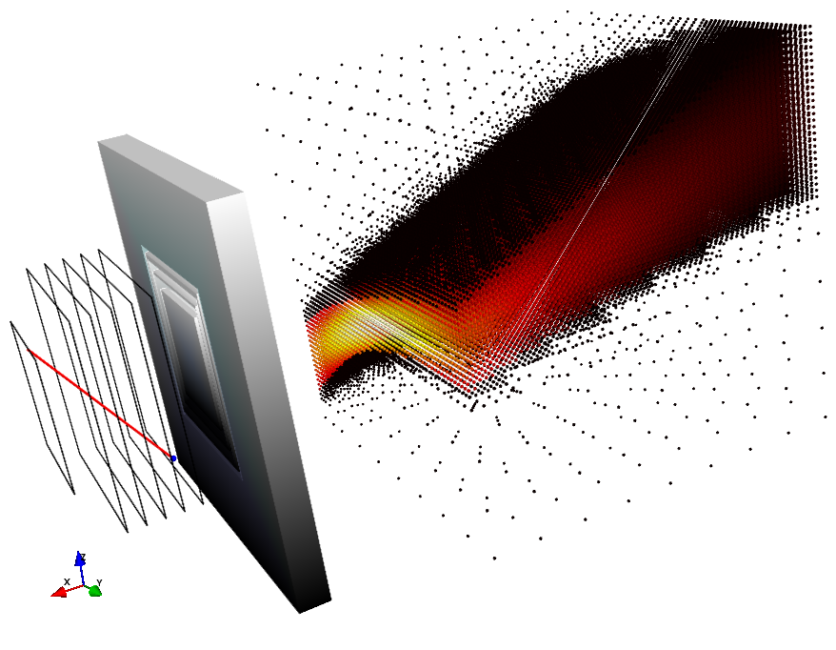
Intermission #1
Simulated collimator reconstruction.

Slide 10
Integration with C++ (1 of 4)
OpenCL API has an official C++ wrapper
  RAII for OpenCL’s reference counting
  Exceptions
  Integrates with STL
  Zero-overhead, pure wrapper only
    If you don’t use exceptions

Slide 11
Integration with C++ (2 of 4)
Qt has a work-in-progress OpenCL module
Uses QObject architecture and conventions
Integrates with Qt OpenGL
Integrates with Qt signals
Non-zero overhead
  But very low
Higher-level API than the official wrapper
  Harder to optimise and specialise

Slide 12
Integration with C++ (3 of 4)
Embedding OpenCL source is tricky
  Embed in binary data (recommended)
    Generate a C header (recommended), or
    Use GNU assembler to embed directly, or
    Use Qt Resource Compiler
  Load from file at runtime
    Requires keeping file separate
I choose to pre-process (cpp) source first
  Easy to share headers between C++ and OpenCL

Slide 13
Integration with C++ (4 of 4)
Compatible with blitz++
  Just use blitz::Array<cl_float, N>
  Copy to/from blitz arrays via their raw pointers
  Allocate pinned (DMA) buffers then wrap with blitz
Compatible with C89 structures
  Nested as deep as you need
  Use OpenCL scalar and vector types, e.g. cl_float4
  But no pointers inside the structure
    Different memory models, beware
    Similarly, no size_t or ptrdiff_t, just use cl_uint
  Flat memory is ideal, copy directly to/from device
  Bonus: Send the same structures directly over MPI

Slide 14
Performance on commodity devices
On NVIDIA GPUs, similar to CUDA
  Higher-level so specialisation is more difficult
  I never had to specialise for NVIDIA
Better ‘value’ with recent AMD GPUs
  In general, not just OpenCL
On CPU, generally slower than C with GCC/ICC
  Threads for you, but so do OpenMP and Cilk Plus
  For thread barriers, you may need to fine-tune for CPU
    Fewer threads, higher cost of barrier, low cost of memory IO
    Have less barriers, do more between the barriers
    Use preprocessor to specialise code on demand

Slide 15
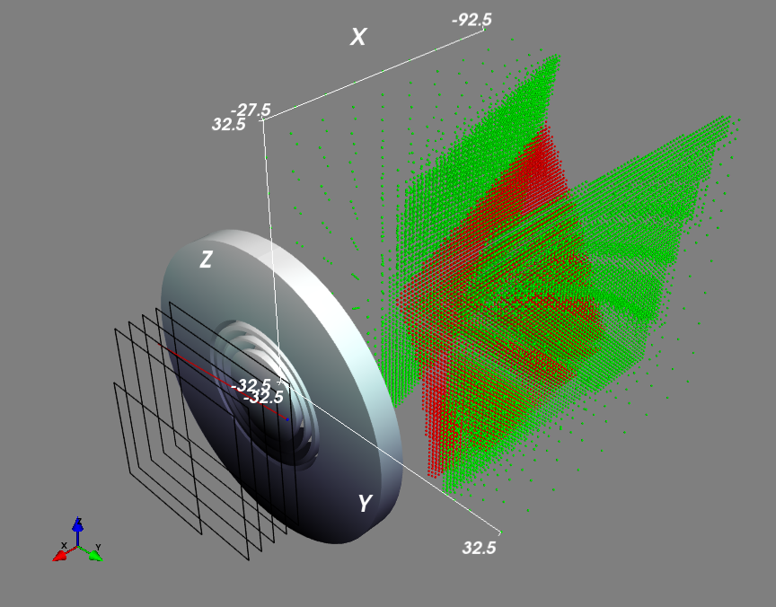
Intermission #2
Simulated collimator reconstruction.

Slide 16
CUDA over OpenCL
More time in the industry
  Larger community
  More libraries
  More developers
More optimised for NVIDIA hardware
  Popular in supercomputers and workstations
Some C++-like features device-side

Slide 17
OpenCL over CUDA
Device-wise, a strict superset of CUDA
  If NVIDIA OpenCL isn’t as fast now, it will be soon
  AMD GPU with OpenCL is faster and cheaper
  Several other implementations available
  Mobile devices, Apple computers, …
OpenCL’s API is more modern than CUDA API
  N-device by design, no cudaSetDevice() nonsense
  Asynchronous by design
  Type safe - device buffers don’t look like host pointers, etc.
  Official C++ wrapper, not just C in C++
  Work group dimensions can be automatic
OpenCL C is better than CUDA C
  Vector operators - don’t repeat yourself per element, easy SIMD
  Many common builtin functions over scalars and vectors

Slide 18
OpenCL extra curiosities
MOSIX group announced MOSIX Virtual OpenCL
  Wraps existing devices with a network server
  OpenCL’s asynchronous API is perfect for a cluster, think MPI
  Run OpenCL clients inside a guest virtual machine
Generate OpenCL live from Python, Scala, …
Write to OpenGL textures and vertex arrays directly
  For games and live visualisation
  Memory is shared and coherent on the card

Slide 19
Conclusions
Very positive experience with OpenCL
  Performance, cleanliness, integration
Try it for your next project
  Or try porting your CUDA to OpenCL
It can be your one computing language
  You still need a host language like C++

Slide 20
Vendor-supplied resources
http://www.khronos.org/opencl/
http://www.nvidia.com/object/cuda_opencl_new.html
http://developer.amd.com/gpu/AMDAPPSDK/Pages/default.aspx
http://software.intel.com/en-us/articles/intel-opencl-sdk/
There is no single “getting started”, everyone has their own
Read documents from vendors appropriate to your project
Almost everything you learn is portable between platforms
Learn the C API, even if you use a high-level wrapper for the project

Slide 21
Questions?

Slide 22
Thank you

